Slide 1
Naive Bayes
Noha Rashad

Slide 2
Agenda
What is Naïve Bayes?
Bayes theorem
How Naïve Bayes Work ?
Types of Naïve Bayes
When to use Naïve Bayes ?
Example
Advantage and Disadvantage
Application of Naïve Bayes

Slide 3
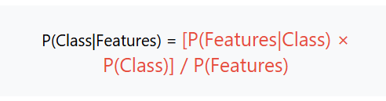
What is Naïve Bayes ?
Is a supervised learning Algorithm based on Bayes theorem and used to solve classification and Regression
Naïve bayes classifier is one of the simple and most effective classification Algorithms which helps in building the fast machine learning models that’s can make quick predictions
Some popular Examples of Naïve Bayes Algorithm are sentimental Analysis ,spam filtration , News Categorization

Slide 4

Bayes Theorem
Helps you to examine the probability of an event based on the prior knowledge of any event that has correspondence to the former event.
Where A and B are Events
P(A∣B(“The probability that event A is true after observing event B.”
This is called the posterior — it’s what we’re trying to calculate.
P(B∣A)“The probability of observing event B, assuming that A is already true.”
This is called the likelihood — how likely the evidence is under the assumption.

Slide 5
  P(A)
“The initial probability that event A is true, before seeing any evidence.”
This is the prior — your belief or knowledge before new data.
  P(B)
“The total probability of observing event B, from all possible causes.”
This is the evidence — it acts as a normalizing factor to ensure the result is a valid probability.

Slide 6
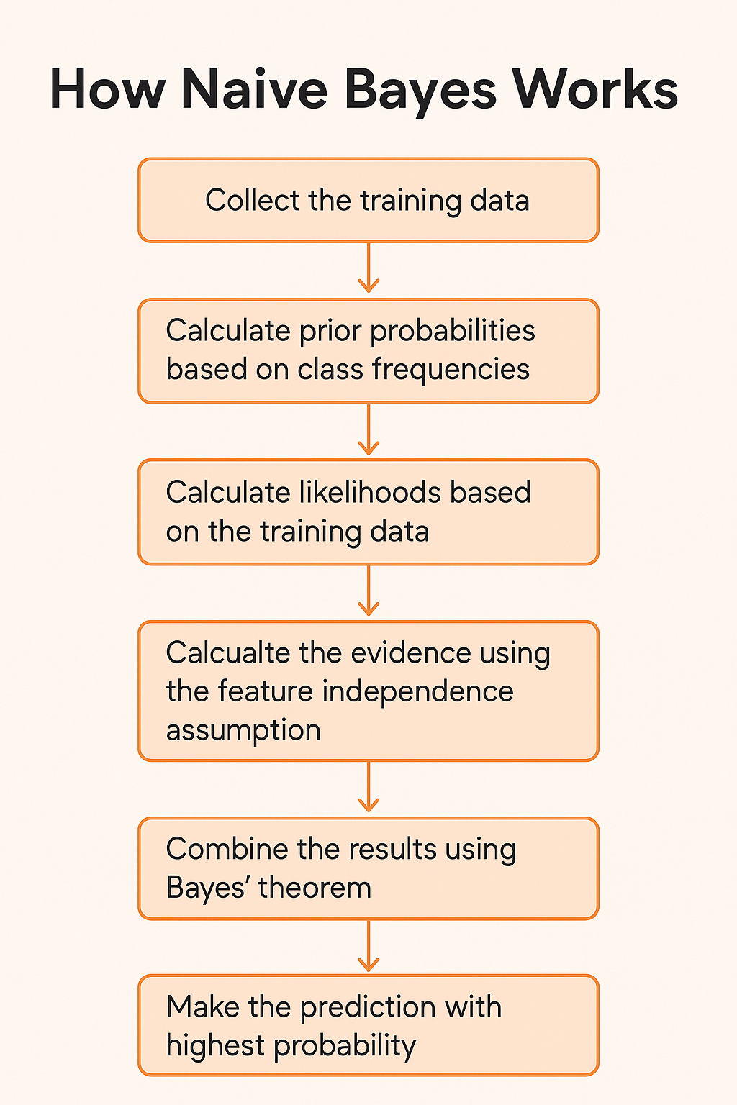

Slide 7
Types of Naïve Bayes classifier
1. Gaussian Naive Bayes
Use for: Continuous (real-valued) data
Assumption: Features follow a normal (Gaussian) distribution
Example: Predicting disease based on age, blood pressure, temperature, etc.
2. Multinomial Naive Bayes
Use for: Discrete data (typically word counts or frequencies)
Assumption: Features represent counts (e.g., how many times a word appears)
Example: Text classification, spam detection, sentiment analysis
3. Bernoulli Naive Bayes
Use for: Binary/Boolean features (0 or 1)
Assumption: Features are binary — e.g., word is present or not
Example: Text classification with binary word presence matrix

Slide 8
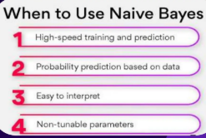

Slide 9
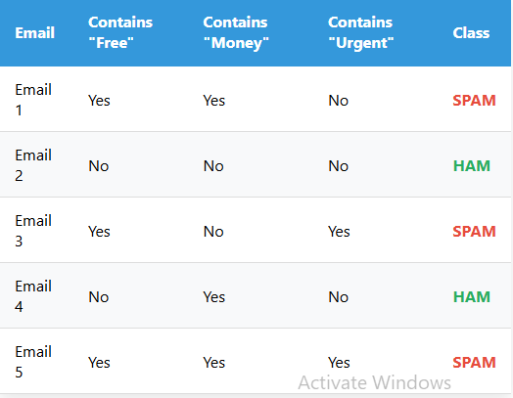
Example
Email Spam Detection

Slide 10
Classification Steps
Step 1: Calculate Prior Probabilities
P(SPAM) = 3/5 = 0.6
P(HAM) = 2/5 = 0.4
Step 2: Calculate Likelihood for Each Feature
For SPAM emails (3 total):
P("Free"|SPAM) = 3/3 = 1.0
P("Money"|SPAM) = 2/3 = 0.67
P("Urgent"|SPAM) = 2/3 = 0.67
For HAM emails (2 total):
P("Free"|HAM) = 0/2 = 0.0
P("Money"|HAM) = 1/2 = 0.5
P("Urgent"|HAM) = 0/2 = 0.0

Slide 11
Step 3: Classify New Email
New Email: Contains "Free" = Yes, "Money" = No, "Urgent" = Yes
For SPAM:
P(SPAM|features) : P("Free"|SPAM) × P("Money"=No|SPAM) × P("Urgent"|SPAM) × P(SPAM)
= 1.0 × (1-0.67) × 0.67 × 0.6
= 1.0 × 0.33 × 0.67 × 0.6 = 0.133
For HAM:
P(HAM|features): P("Free"|HAM) × P("Money"=No|HAM) × P("Urgent"|HAM) × P(HAM)
= 0.0 × (1-0.5) × 0.0 × 0.4
= 0.0 × 0.5 × 0.0 × 0.4 = 0.0
Classification Result: SPAM (0.133 > 0.0)

Slide 12
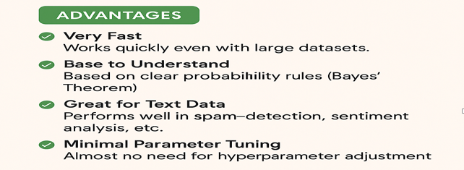

Slide 13
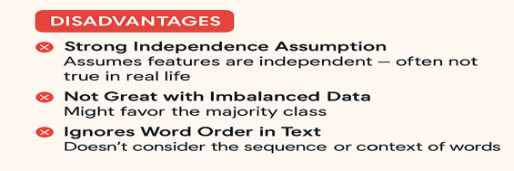

Slide 14
